Slide 1




Thynk Unlimited
Project 2
SECP3623 Database Programming
Section 02
Presented By
Group 5

Slide 2

Part 1: Brief Case Study Introduction

Slide 3
Event Management System
Manual event management is inefficient
Common Problems:
Real-world use cases:
01
Scattered event information
01
University programs
02
Manual registration & attendance tracking
02
Workshops & seminars
03
Difficult to analyze participation data
03
Community events
Notes:
“For our project, we chose an Event Management System as our case study.
In many real-world scenarios such as university programs, workshops, or community events, event management is often handled using spreadsheets, forms, or manual records.
This approach leads to several issues. Event information becomes scattered, registrations are difficult to track, and organizers struggle to manage participants and attendance efficiently. As the number of events grows, it also becomes hard to analyze data such as which events are most popular or how many users actively participate.
To solve this, our system provides a centralized platform where all event-related data is stored in a single NoSQL backend using MongoDB.

Slide 4
What Does Our System Manage?
Centralized NoSQL backend using MongoDB
Core Data Components:
Supports:
Users - attendees & organizers
Events - event details & ticket types
Registrations - user-event relationships
Sessions - agendas within events
Event creation & updates
User registration
Ticket & payment records
Attendance & analytics
Notes:
Our system is designed around four main data components.
First, the Users collection stores all attendees and organizers in one place.
Second, the Events collection stores event details such as title, location, date, and ticket options.
Third, the Registrations collection links users to events and records transactional data such as ticket type and payment status.
Finally, the Sessions collection stores individual agendas within each event, such as time slots and speakers.
With this structure, organizers can create and manage events, users can register, and the system can track participation accurately. More importantly, the data can be analyzed to generate insights, such as total registrations per event, popular sessions, or user activity patterns.
This makes the Event Management System a realistic and suitable domain to demonstrate NoSQL modelling, CRUD operations, indexing, and aggregation, which will be explained in the next section.”

Slide 5
Part 2: NoSQL Modelling Explanation

Slide 6

Overview of Data Model
Collections Used
users
events
registrations
sessions
Design Approach
Combination of embedding and referencing
Avoids data duplication
Improves performance and maintainability

Slide 7
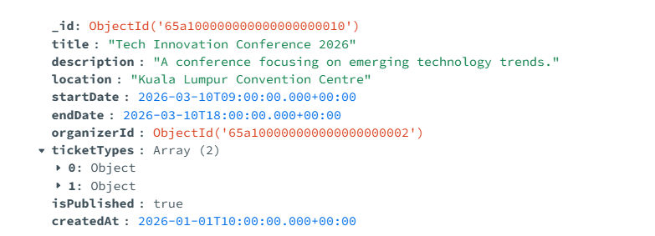
Event Collection
Collection Purpose
Stores core event information such as title, location, and schedule
Managed by event organizers
Implementation Approach
Ticket types embedded as an array
Organizer linked using a reference to users
Event dates stored using Date data type
Design Justification
Acts as a central source for event data
One event can offer multiple ticket types
Event details are frequently accessed

Slide 8
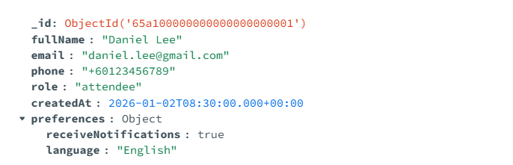
Users Collection
Collection Purpose
Stores user profiles such as attendees and organizers
Each user is uniquely identified in the system
Implementation Approach
User details stored as a single document
Preferences stored as embedded documents
User ID referenced by other collections
Design Justification
One user may participate in multiple events
Prevents duplication of user data across registrations
Ensures consistency when user details are updated

Slide 9
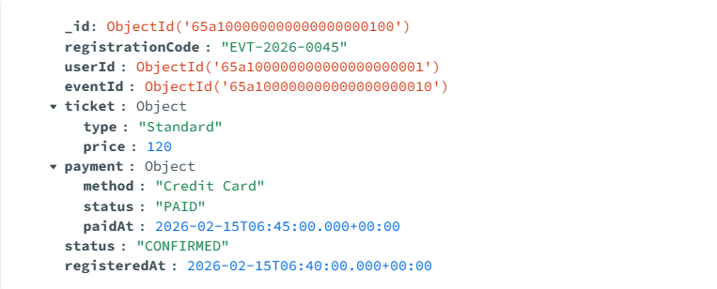
Registrations Collection
Collection Purpose
Records user participation in events
Stores registration and payment details
Implementation Approach
User ID and Event ID stored as references
Ticket and payment information embedded
Status field used for confirmation tracking
Design Justification
Represents the relationship between users and events
Maintains a history of transactions
Supports registration status tracking

Slide 10
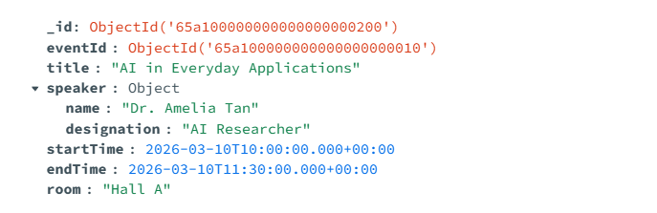
Sessions Collection
Collection Purpose
Stores event agendas and session schedules
Each session belongs to a specific event
Implementation Approach
Event ID referenced to link sessions to events
Speaker details embedded in session document
Time values stored using Date data type
Design Justification
Events can contain multiple sessions
Each session has different speakers and timings
Improves structured event management

Slide 11
Part 3: CRUD Implementations

Slide 12
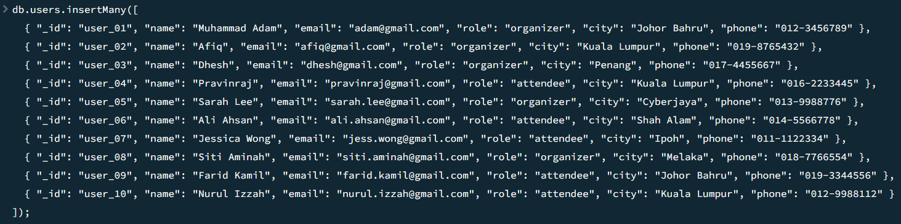
Insert Operations
Adding Data to the System
We used the insertMany() command to quickly add 10 records to each collection..
Ticket information was "embedded" inside each event document.
This makes it faster to see all event details without searching another table.

Slide 13
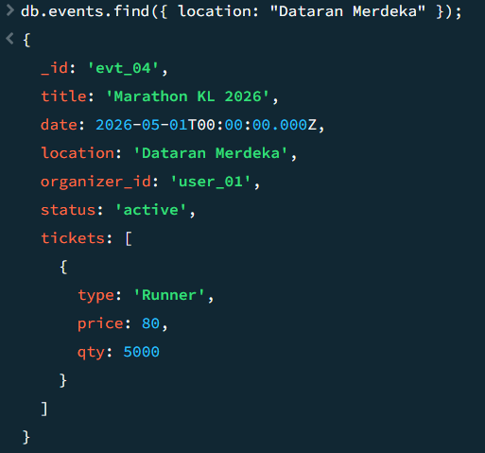
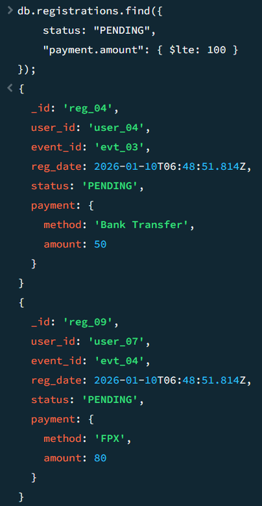
Query Operation
Searching for Information
We used the find() method to filter and pull out specific data.
Simple Search: We found all events happening at "Dataran Merdeka".
Complex Search: We used math operators like $lte (less than or equal) to find cheap tickets.

Slide 14
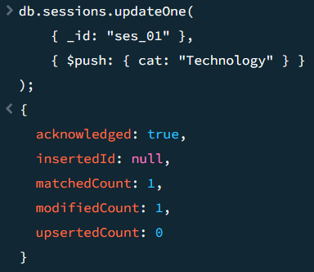
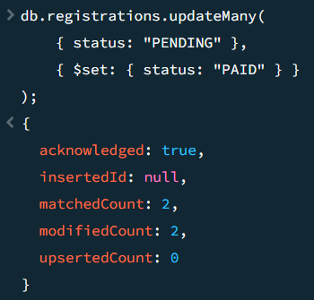
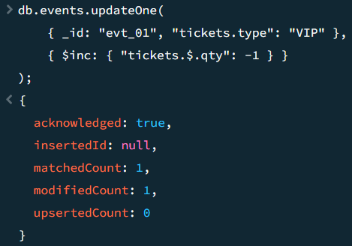
Update Operation
Changing and Managing Data
$set Operator: We used this to change a specific user's phone number without affecting other data.
$push Operator: We added new categories to a session's list, showing that our database can grow dynamically.
$inc Operator: This was used for "atomic counters" to automatically increase or decrease ticket counts during bookings.

Slide 15
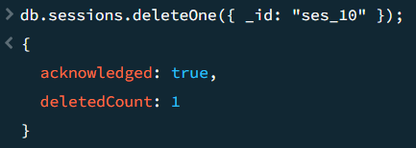
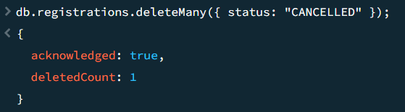
Delete Operation
Removing Records and Data Hygiene
deleteOne: We targeted and removed a specific document using its unique ID (e.g., a specific session).
deleteMany: We performed batch deletions to remove all registrations marked as "CANCELLED".
Purpose: This process saves storage space and keeps the database clean and organized.

Slide 16
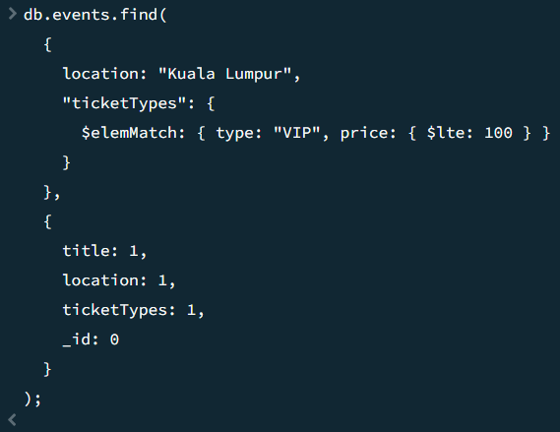
Projection and Query Test
Query Test: We proved the system handles hard questions, like finding "VIP" tickets under RM 100 in Kuala Lumpur.
Projections: We used these to "hide" messy ID numbers and internal codes in the search results.

Slide 17
Part 4: Indexing, Aggregation & Sorting

Slide 18
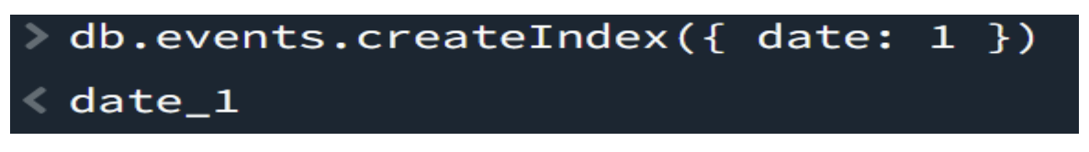
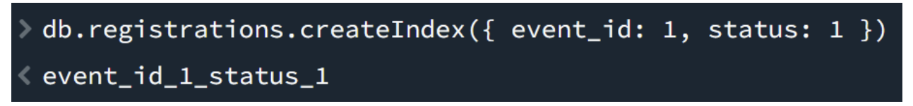
Indexing
Why Indexing?
Improves query performance
Avoids full collection scans
Important for large datasets
Indexes Implemented
Single-field index on events.date
Compound index on registrations.event_id + status

Slide 19
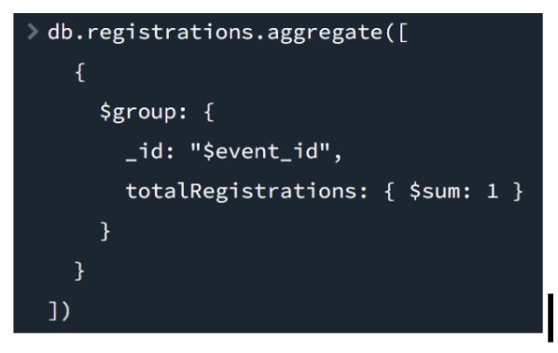
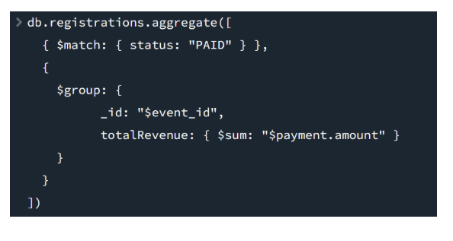
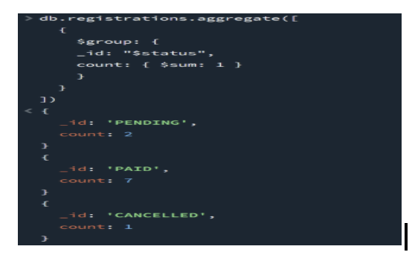
Aggregation Pipelines
Purpose
Summarize and analyze data
Generate insights from registrations
Examples
Total registrations per event
Total revenue per event
Registration status summary

Slide 20


Sorting
Benefits
Better readability
Useful for reporting & analysis
Sorting Demonstrations
Events sorted by date (ascending)
Events sorted by date (descending)
Registrations sorted by payment amount

Slide 21
Part 5: Team Member Contributions

Slide 22
Team Contribution - Adam
CRUD Implementation: I developed and executed the essential insert, update, and delete operations across all collections to ensure a functional backend.
Query Logic & Testing: I designed and verified complex query filters using operators like $lte and $and to retrieve specific event and registration data.
Data Projection: I implemented projections to filter out internal identifiers and unnecessary fields, ensuring the database output was clean and readable for reporting.

Slide 23
Team Contribution - Afiq
Case Study Introduction: I prepared the case study overview for the presentation and clearly explain the problem, system purpose and why this domain is suitable for demonstrating NoSQL concepts.
Security & Challenges: I analyzed and documented NoSQL security concerns including access control, injection risks and consistency trade-offs in distributed systems to ensure our project addresses both technical and conceptual aspects beyond implementation
Notes:
“For my contribution in this project, I focused on two main areas.
First, I prepared the Case Study Introduction for our presentation, where I clearly explained the real-world problem, the system’s purpose, and why an Event Management System is a suitable domain for demonstrating NoSQL concepts.
Second, I handled the Security and Challenges section. I analyzed and documented key NoSQL security concerns, including access control, injection risks, and consistency trade-offs in distributed systems.
These contributions helped ensure that our project is not only technically implemented, but also conceptually strong and aligned with real-world system considerations.”

Slide 24
Team Contribution - Pravin
Advanced MongoDB Operations (Indexing & Aggregation): I implemented advanced MongoDB operations by creating both single-field and compound indexes to improve query performance and support efficient data retrieval in the event management system.
Aggregation Pipeline Design: I designed and executed aggregation pipelines to generate analytical insights, including total registrations per event, total revenue per event, and registration status summaries for better decision-making.
Sorting and Query Performance Analysis: I demonstrated sorting operations in ascending and descending order and explained how indexing enhances query speed and optimizes database performance.

Slide 25
Team Contribution - Dhesh
NoSQL Data Modelling: I designed the MongoDB NoSQL data model by identifying the core collections required for the event management system and defining their roles and responsibilities.
Collection Structure Design: I created structured MongoDB collections with appropriate fields, nested documents, and arrays to accurately represent real-world event, user, registration, and session data.
Embedding vs Referencing Decisions: I determined when to use embedded documents and when to apply references between collections to minimize data redundancy while maintaining data consistency.

